Slide 1
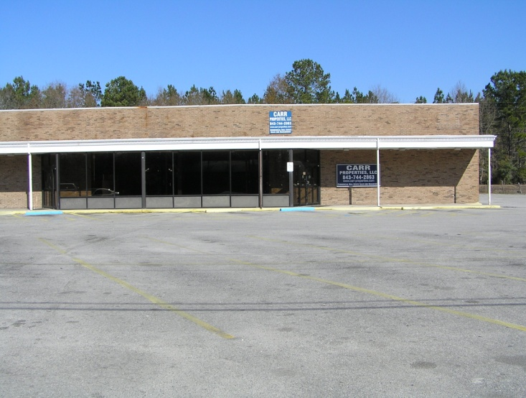
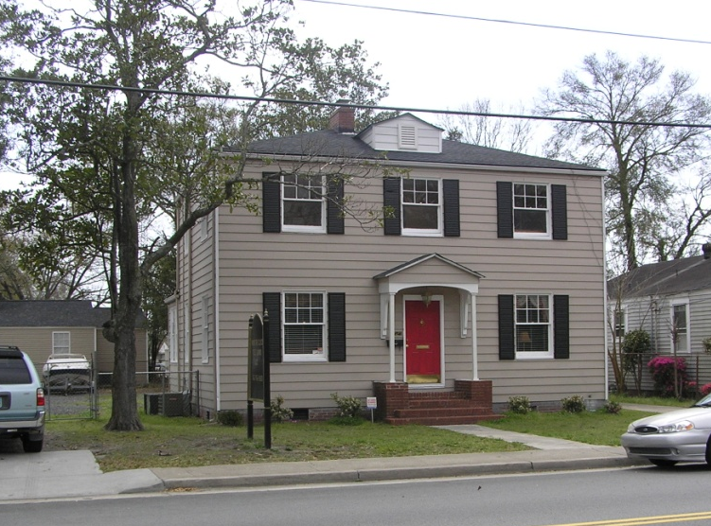
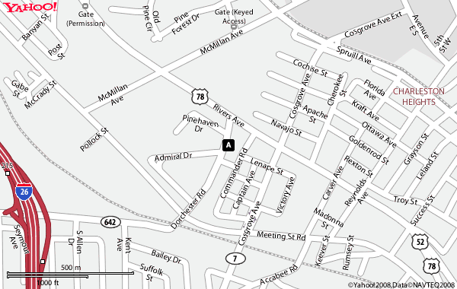
For Sale
2125 Dorchester Rd.
N. Charleston, SC
  Price: $ 210,000.00
  TMS # 469-11-00-034
  Lot: 120x90x123x70= 9,720 sf
  Office Building
Very clean, tastefully
decorated recently
2 curb cuts for convenient
ingress/egress
Plenty of parking
Well suited for professional use
Within sight of former Naval
hospital and Chas. County
Sheriff’s office.
Floor plan on reverse side
MLS # 2809380
14,940 sf / $ 5,600 /mo*
Sale Price: $599,000
Directions:
From I-26, take Dorchester Road exit 215, 1 mile east on Dorchester Road, just before Rivers Avenue.
Offered by Carr Properties, LLC
Walter Carr, BIC
5806 Campbell St.
Hanahan, SC 29406
843-744-2863 office
843-744-0321 fax
www.carr-properties.com
carrpropllc@aol.com
COMMERCIAL REAL ESTATE ~ SALES ~ LEASING ~ MANAGEMENT ~ DEVELOPMENT

Slide 2
